Slide 1
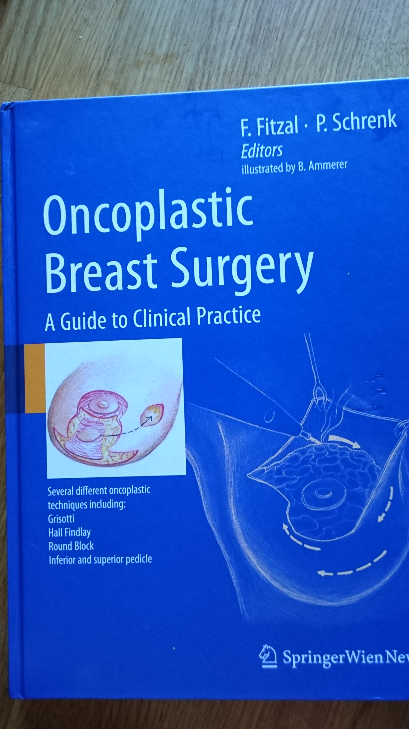
Mer läsning…

Slide 2
Vidareutbildning, kurser, möten…
www.breastsurgeonsweb.com
www.orbsmeetings.com
www.orbsweb.com
https://www.rcseng.ac.uk/courses/course-search/specialty/breastsurgery.html
www.milan-oncoplastic.com
http://www.eec-fr.com/site/en/formations_en_2/senology/oncoplastic-masterclass/
http://www.remittent.se/sv/Videoarkiv/Oppen-kirurgi/Brostkirurgi/Brostreduktionsplastik-en-teknikbeskrivning/
OncoPlastic App

